Slide 1
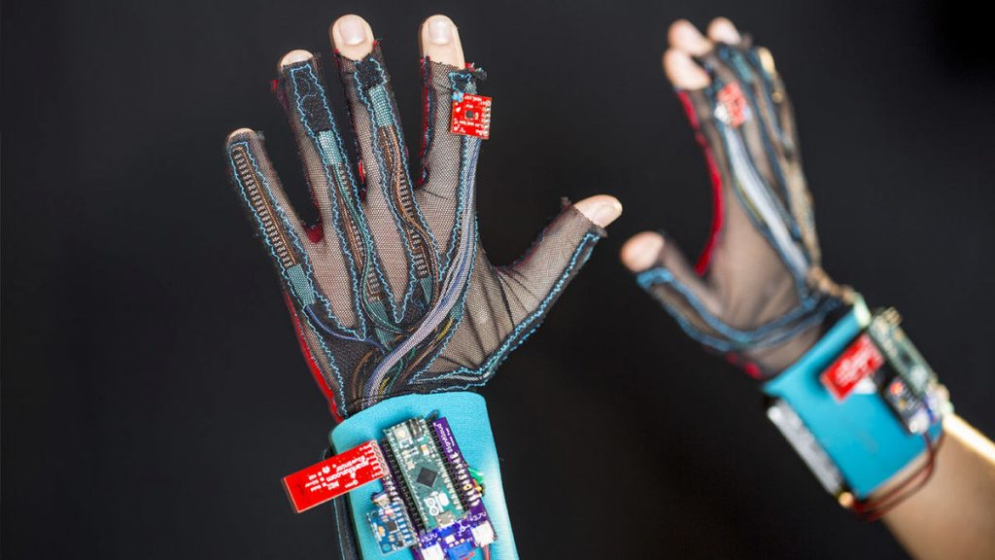
CPG No: 73
SAMVAAD SAARTHI
A Project Presentation by :
Sezalpreet Kaur 102103531
Yatharth Gautam 102103550
Mannat Sadana 102103561
Arshiya Kishore 102103565
Aakarsh Walia 102153005
Under the mentorship of
Dr. Vaibhav Pandey
Assistant Professor

Slide 2
TABLE OF CONTENT
Background of Project | 3
Scope and Utility of Project | 4
Objectives | 5
Literary Survey | 6
Tools and Components | 7
Block and Use Case Diagram | 8
Snapshots of the Project | 9
Activity Diagram | 10
Work Mechanics | 11
Deliverables | 12
Professional and Technical Learning | 13
Project Outcomes | 14
Results and Performance Analysis | 15
Our Roles | 16

Slide 3
01 | Addressing Communication Challenges
02 | Challenges of Conventional Techniques
03 | Complexities of ISL
04 | Advancing Inclusivity
05 | Advancing Equality and Respect
BACKGROUND OF THE PROJECT
WHY DO WE NEED SAMVAAD SAARTHI?

Slide 4
01 | Inclusive Communication: Translates gestures into Hindi speech for better interaction.
02 | Affordable Assistive Tool: Cost-effective solution for education and personal use.
03 | Customizable and Scalable: Supports multiple languages and future mobile app integration.
04 | Educational Aid: Simplifies learning and teaching of sign language.
SCOPE AND UTILITY OF THE PROJECT

Slide 5
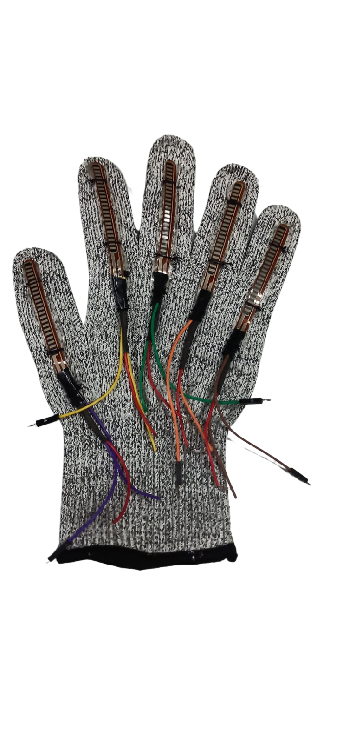
OBJECTIVES
WHAT PROBLEM DOES SAMVAAD SAARTHI solve?
Converts sign language into audio outputs.
Provides workplace-specific customization.
Promotes inclusivity and productivity by breaking communication barriers.
Enhances accessibility to make communication seamless.

Slide 6

LITERATURE SURVEY
AHMED J ABOUGARAIR
(AMERICAN SIGN LANGUAGE INTO SPEECH AND TEXT)
JASON PARRY
(AMERICAN SIGN LANGUAGE INTO SPEECH AND TEXT)
WOEI SHENG WONG
(TRANSLATING MALAYSIAN SIGN LANGUAGE)
AMAL DWEIK
(TRANSLATE THE ARABIC SIGN LANGUAGE )
A.HARITHA
(INDIAN SIGN LANGUAGE INTO SPEECH AND TEXT)
DIVYA P S
(AMERICAN SIGN LANGUAGE INTO SPEECH AND TEXT)

Slide 7
TOOLS AND COMPONENTS
HARDWARE FLex sensors Arduino Nano IOT board for data processing | SOFTWARE Arduino IDE for coding
POWER AND CONNECTIVITY COMPONENTS Wires Batteries | HARDWARE SD card/memory Speaker DFPlayer Mini

Slide 8
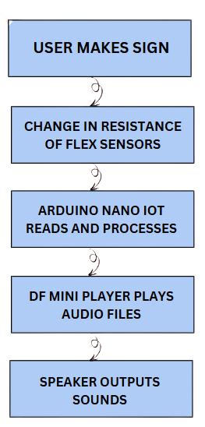
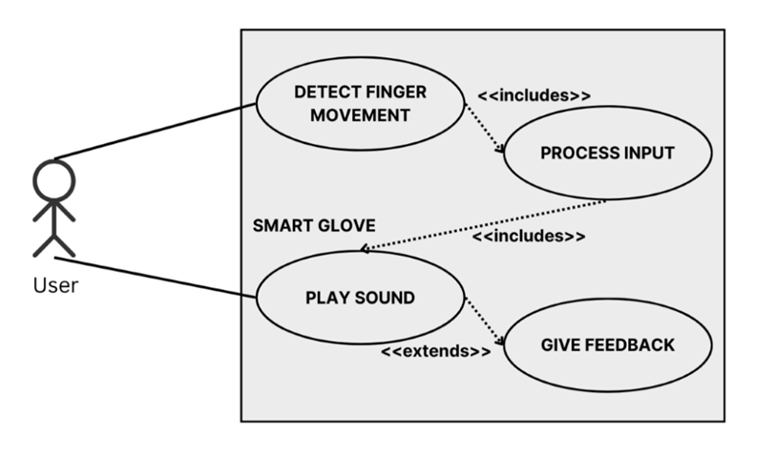
BLOCK DIAGRAM
USE CASE DIAGRAM

Slide 9
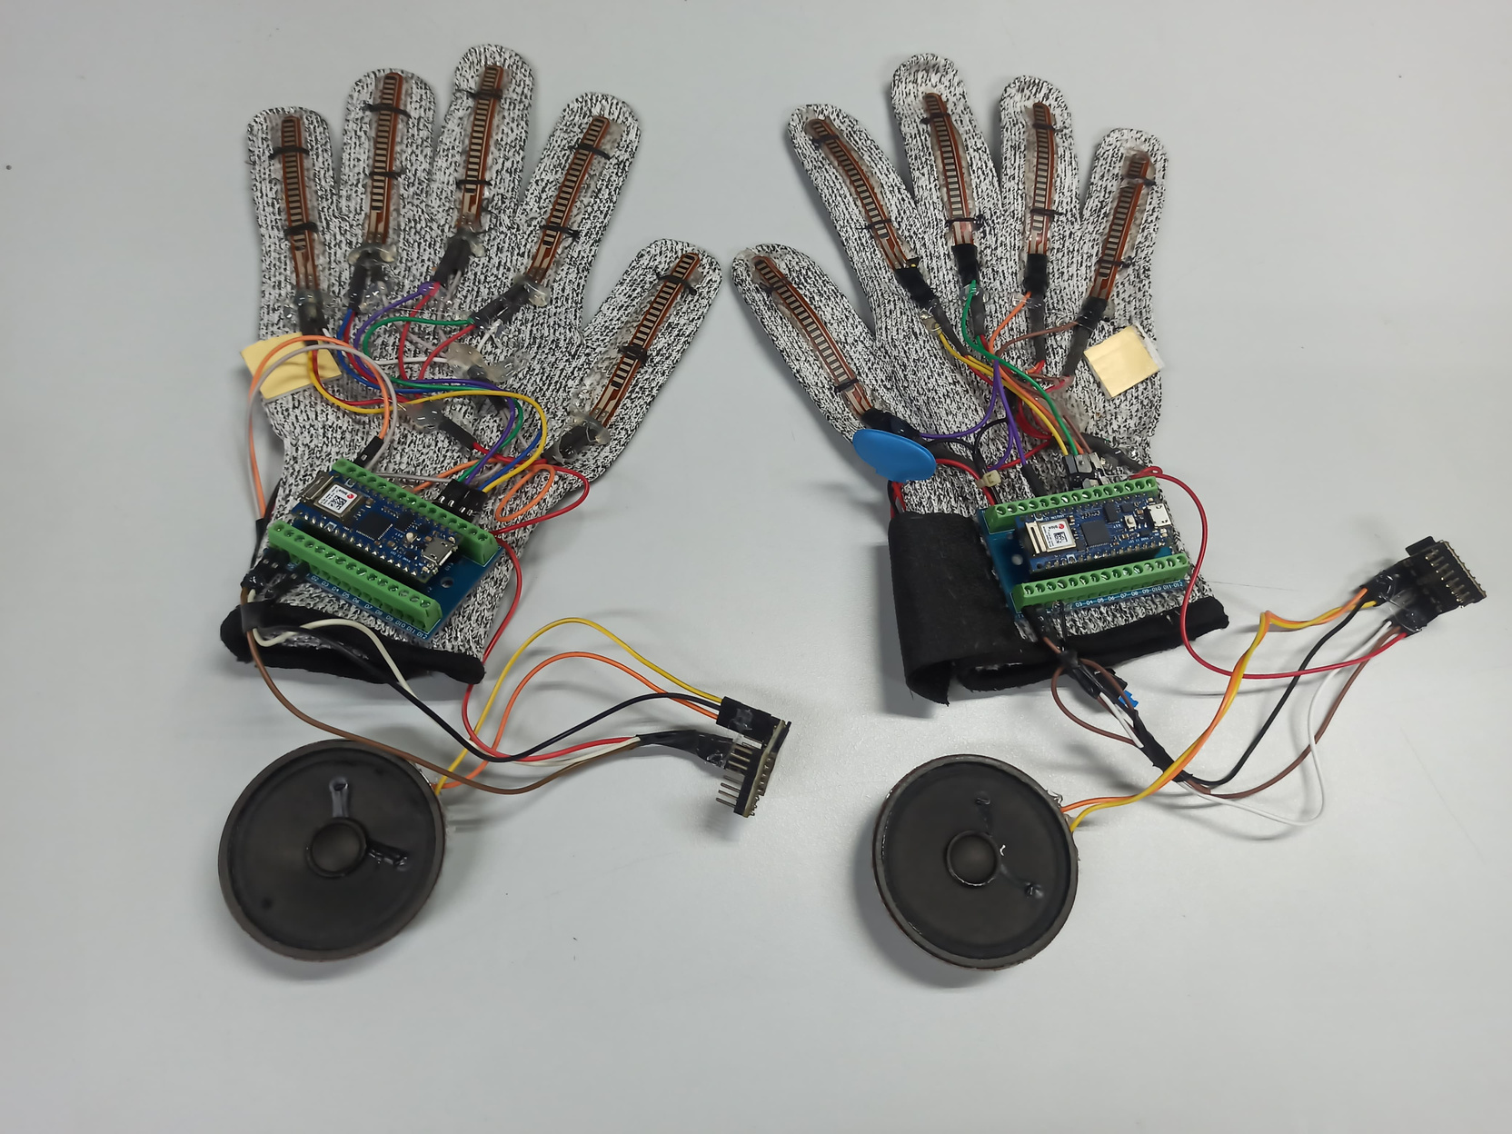
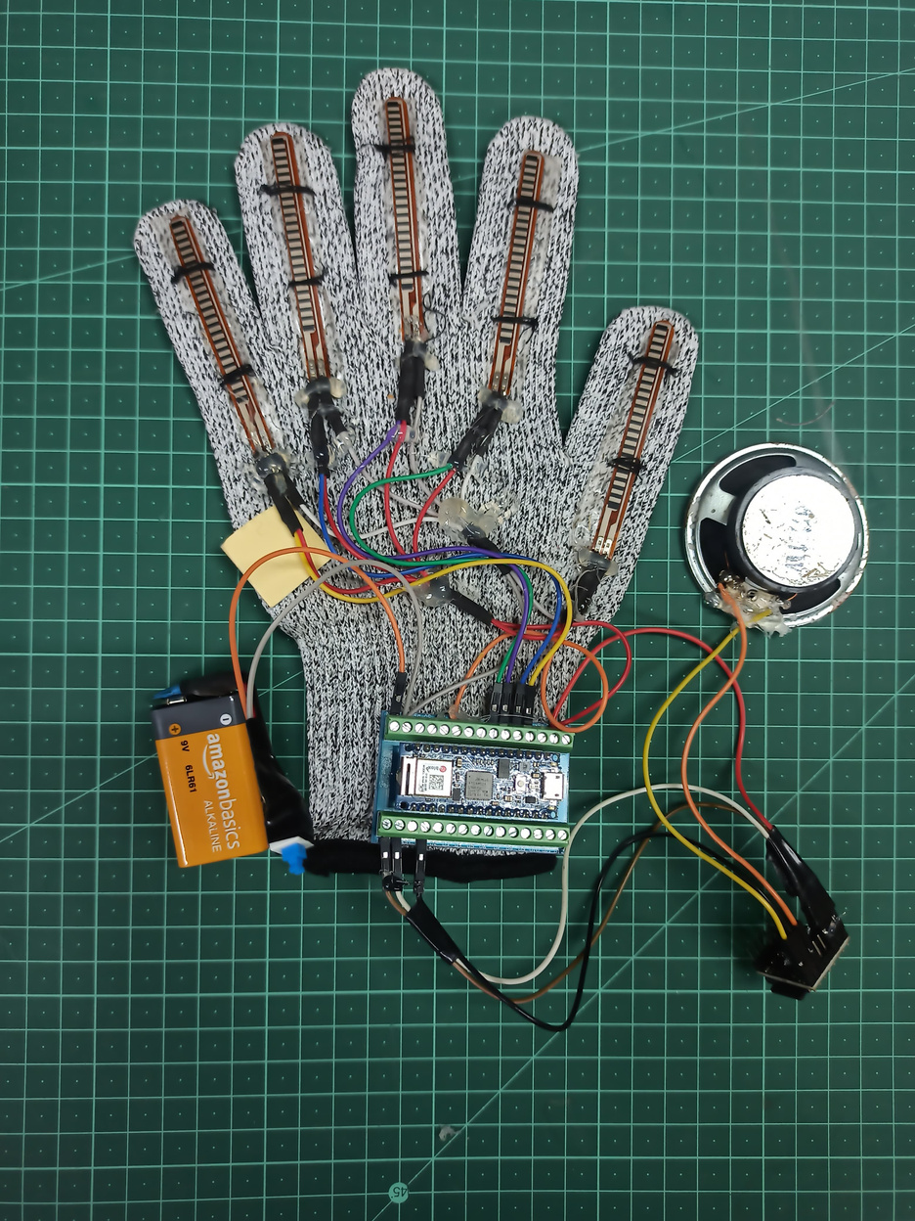
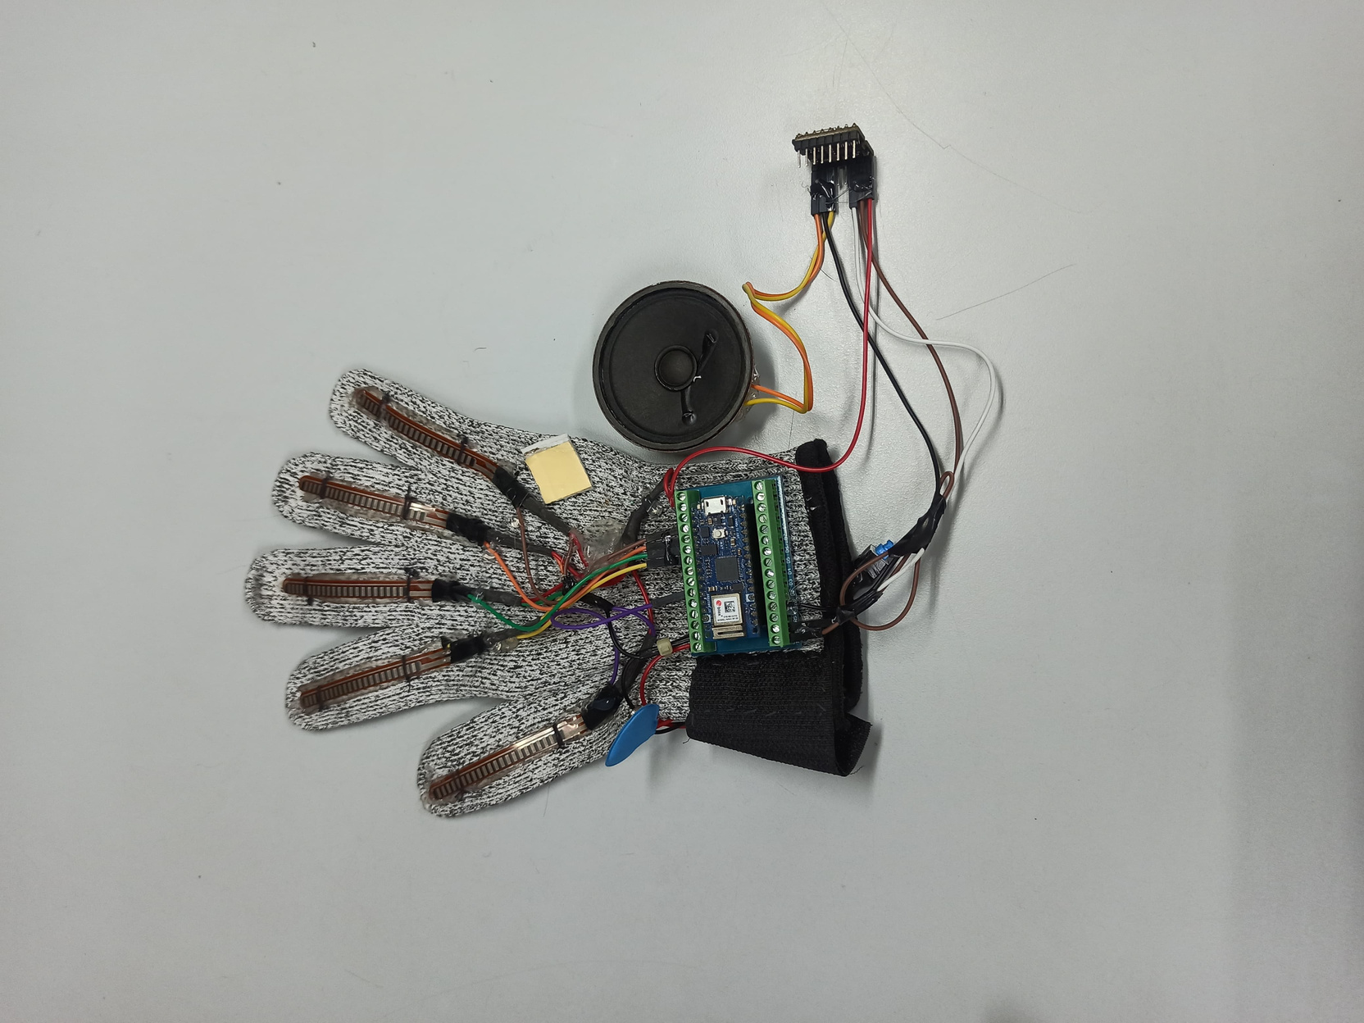
SNAPSHOTS OF THE PROJECT

Slide 10

ACTIVITY DIAGRAM
User wears the glove and makes a sign
Flex sensors detect finger movements
Generate command for DF Mini Player
Measure resistance changes in flex sensors
Send command to play corresponding audio file
Arduino Nano reads sensor data
DF Mini Player plays audio file
Process resistance data to identify the sign
Speaker outputs sound
Yes
Sign Detected?
No
Handle Unknown gesture or retry

Slide 11
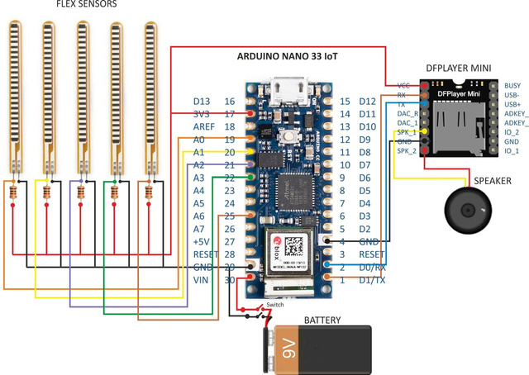
Data Collection
Data Interpretation
Data Transmission
WORK MECHANICS
DATA PRE-PROCESSING WITH DATABASE
Flex sensors in the glove measure finger bending, capturing hand posture data.
The Arduino processes this data to identify specific hand gestures.
The processed data is compared to a stored gesture database to identify the corresponding gesture or alphabet.
Data-to-Speech Conversion
Final Output

Slide 12
DELIVERABLES
Gesture Recognition: Converts gestures into Hindi speech for seamless communication.
Customizable for Environments: Adaptable glove design tailored to specific settings like factories or workplaces.
High Accuracy and Usability: Achieved 92% gesture recognition accuracy in controlled environments.
Portable and Affordable: Compact, cost-effective, and user-friendly for broader accessibility.

Slide 13
PROFESSIONAL AND TECHNICAL LEARNING
Project Development Lifecycle: Gained hands-on experience in planning, designing, and implementing a complete hardware-software solution.
Hardware Integration: Gained expertise in integrating sensors, microcontrollers, and audio modules.
Embedded Systems Expertise: Worked with Arduino Nano, flex sensors, and DF Mini Player for real-time data processing and output.
Gesture Recognition: Enhanced understanding of flex sensor calibration and pattern matching algorithms.
Problem-Solving: Tackled real-world challenges, improving adaptability and innovative thinking.

Slide 14
PROJECT OUTCOMES
IMPROVED ACCESSIBILITY | EFFICIENT COMMUNICATION | TECHNOLOGICAL INNOVATION | CUSTOMIZABILITY AND ADAPTABILITY | ENGAGEMENT AND COLLABORATION
Real-time ISL translation, Empowering the deaf community | Automated gesture-to-speech conversion, Boosting productivity and clarity | Pioneering breakthrough solutions, Showcasing innovation in disability support | Personalized statement storage, Improved usability and adaptability | Collaborative development approach, Incorporating user feedback

Slide 15
01 | Accuracy : 92% in controlled environment
02 | Accuracy: 88% in real-world testing
03 | Minimal Latency enabling real-time translation
04 | Advancing Inclusivity
05 | Feedback: High satisfaction with glove usability and comfort
RESULTS AND
PERFORMANCE
ANALYSIS

Slide 16
Sezalpreet Kaur
OUR ROLES
Idea finalization, Documentation, Hardware Implementation
Yatharth Gautam
Idea finalization, Documentation, Hardware Implementation
Mannat Sadana
Idea finalization, Documentation, Hardware Implementation
Arshiya Kishore
Idea finalization, Documentation, Hardware Implementation, Integration of hardware and software
Aakarsh Walia
Idea finalization, Documentation, Integration of hardware and software

Slide 17
THANK
YOU

